Slide 1
State Income Tax Refund & Alimony
4491-08-C Income - State Income Tax Refund and Alimony v11.0 VO.pptx
Notes:
1

Slide 2
New Jersey Income Tax Refunds
Reported only if Taxpayer itemized deductions last year.
Claimed deduction for state/local income tax
Not reported if Sales Tax deducted in prior year
Report on line 10 – Form 1040
Link to “State Tax Refund Worksheet” if have prior year information
Need prior year data to calculate whether partially taxable
If do not have prior year data, then all taxable – enter directly on 1040 Pg 1 line 10

Slide 3
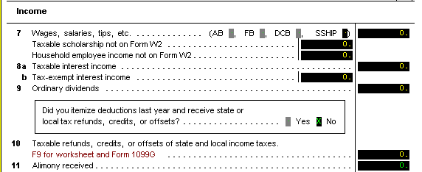
Alimony
Alimony Received Is Taxable
Notes:
3

